Slide 1
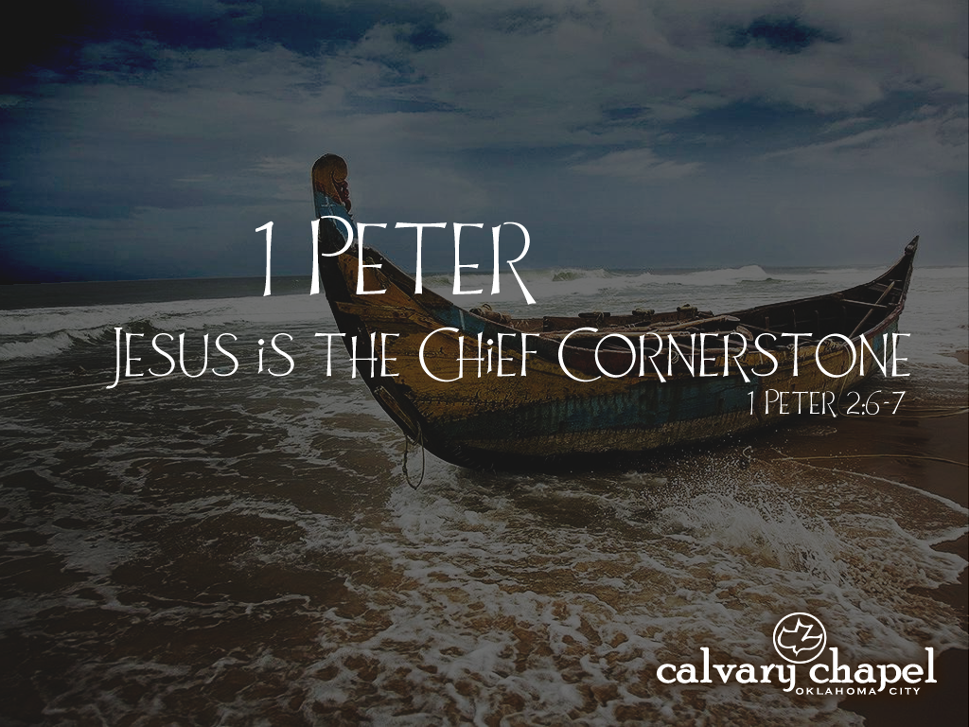
4:1-1o

Slide 2
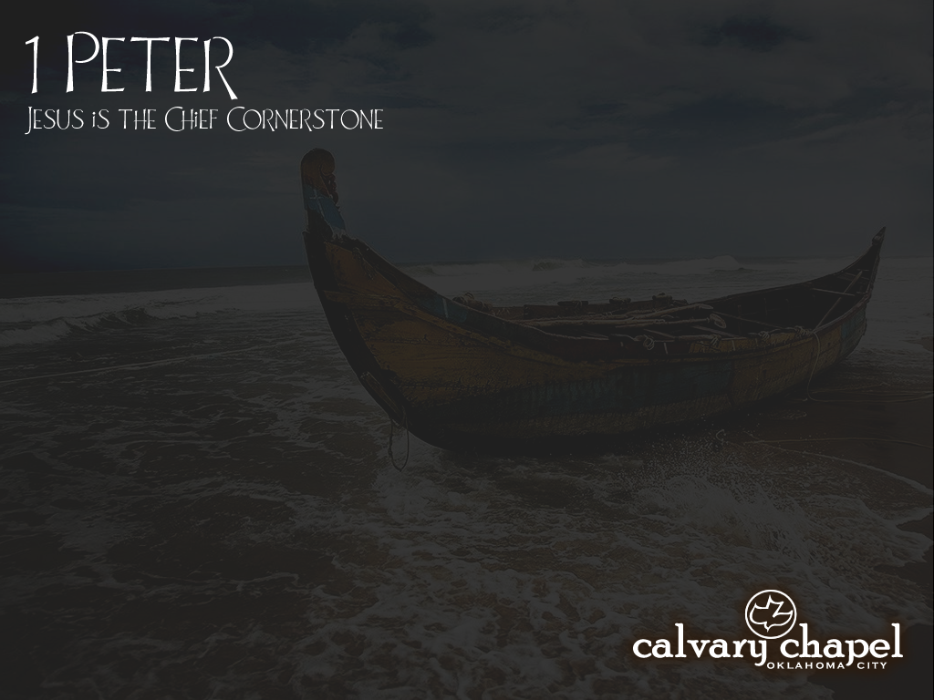
4:1-1o
3:18a ~ For Christ also suffered once for sins, the just for the unjust, that He might bring us to God,
Verses related to Christian tribulatin’ in 1 Peter:
1:6
1:11
2:19-24
3:16-17
4:12-16
5:10

Slide 3
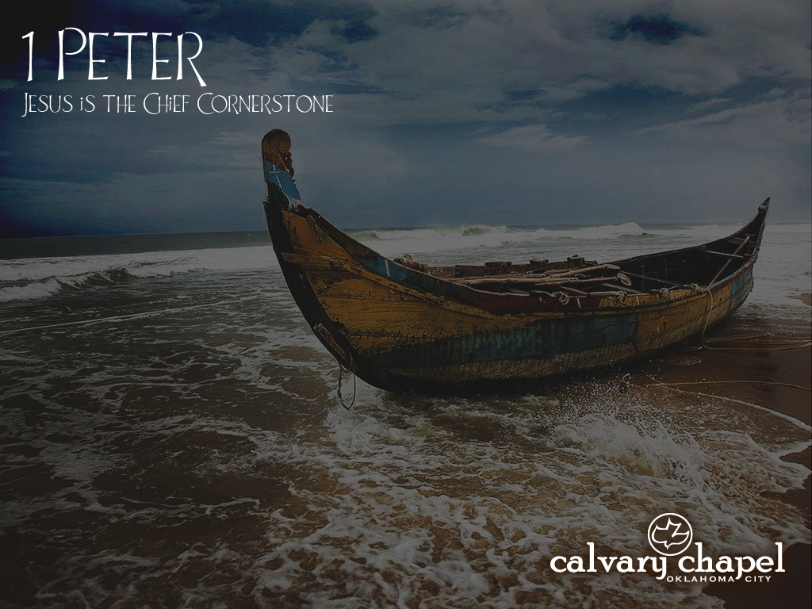
4:1-1o

Slide 4
4:1-1o
1 Peter 4:1–10 ~ ¹ Therefore, since Christ suffered for us in the flesh, arm yourselves also with the same mind, for he who has suffered in the flesh has ceased from sin, ² that he no longer should live the rest of his time in the flesh for the lusts of men, but for the will of God. ³ For we have spent enough of our past lifetime in doing the will of the Gentiles—when we walked in lewdness, lusts, drunkenness, revelries, drinking parties, and abominable idolatries. ⁴ In regard to these, they think it strange that you do not run with them in the same flood of dissipation, speaking evil of you.

Slide 5
4:1-1o
1 Peter 4:1–10 ~ ⁵ They will give an account to Him who is ready to judge the living and the dead. ⁶ For this reason the gospel was preached also to those who are dead, that they might be judged according to men in the flesh, but live according to God in the spirit.
⁷ But the end of all things is at hand; therefore be serious and watchful in your prayers. ⁸ And above all things have fervent love for one another, for “love will cover a multitude of sins.” ⁹ Be hospitable to one another without grumbling. ¹⁰ As each one has received a gift, minister it to one another, as good stewards of the
manifold grace of God.

Slide 6
4:1-1o

Slide 7
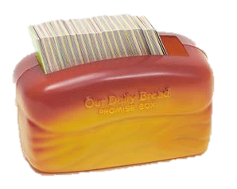
4:1-1o
John 16:33 ~ These things I have spoken to you, that in Me you may have peace. In the world you will have tribulation; but be of good cheer, I have overcome the world.
“For thou, Lord, art good, and ready to forgive; and plenteous in mercy unto all them that call upon thee.”
– Exodus 14:14
The righteous cry out, and the LORD hears them; he delivers them from all their troubles..
– Psalms 34:17
“But my God shall supply all your need according to his riches in glory by Christ Jesus.”
– Exodus 14:14
“Wait on the Lord: be of good courage, and he shall strengthen thine heart;”
– Psalm 27:14b
“There is a friend that sticketh closer than a brother.”
– Proverbs 18:24
“And we know that in all things God works for the good of those who love him,”
– Romans 8:28a
He giveth power to the faint; and to them that have no might he increaseth strength.
– Exodus 14:14
This Photo by Unknown Author is licensed under CC BY-NC-ND

Slide 8
4:1-1o

Slide 9

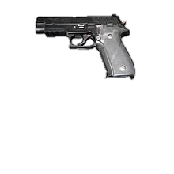
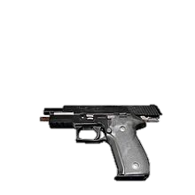

4:1-1o
arm ~ verb form of the noun “weapon” – hoplizō
literally, “weaponize”
ceased (also KJV, NASB)
bang
perfect tense, passive voice
SIN
NIV – is done with, or has been released from
NLT ~ For if you have suffered physically for Christ, you have finished with sin.

Slide 10
4:1-1o

Slide 11
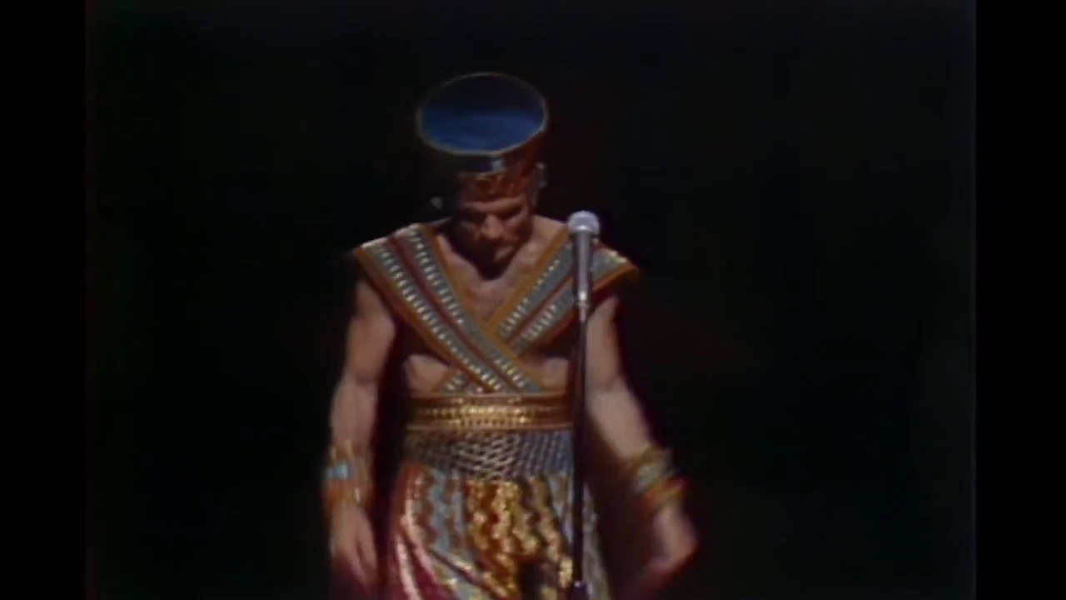
4:1-1o

Slide 12
4:1-1o

Slide 13
4:1-1o
2nd chance from the grave
Announcement of victory (however, it’s euaggelizō, not kerussō)
Dead Christians
Spiritually dead

Slide 14
4:1-1o

Slide 15
4:1-1o
2 Pet. 3:9 ~ The Lord is not slack concerning His promise, as some count slackness, but is longsuffering toward us, not willing that any should perish but that all should come to repentance.
2 Pet. 3:8 ~ But, beloved, do not forget this one thing, that with the Lord one day is as a thousand years, and a thousand years as one day.

Slide 16
4:1-1o
Rom. 13:12 ~ The night is far spent, the day is at hand. Therefore let us cast off the works of darkness, and let us put on the armor of light.
1 John 3:2-3 ~ ² Beloved, now we are children of God; and it has not yet been revealed what we shall be, but we know that when He is revealed, we shall be like Him, for we shall see Him as He is. ³ And everyone who has this hope in Him purifies himself, just as He is pure.

Slide 17


4:1-1o
GOD
NOW
PAST
PRESENT
FUTURE
watchful ~ nēphō – to be sober, to be calm and collected in spirit

Slide 18
4:1-1o

Slide 19
4:1-1o
Prov. 10:12 ~ Hatred stirs up strife, but love covers all sins.
fervent ~ to stretch out

Slide 20
4:1-1o

Slide 21
4:1-1o
hospitable ~ philoxenos – lover of strangers

Slide 22
4:1-1o

Slide 23



4:1-1o
gift ~ charisma
BIBLICALLY
BALANCED
Charismatic
Cessesationist
gift-o-meter

Slide 24
4:1-1o
minister ~ present participle – literally, serve and keep on serving
stewards ~ oikonomos
oikos
nomos
oikos ~ house; nomos ~ law – i.e. house ruler or manager
economy
Webster’s ~ Careful or thrifty management or use of resources, as income, materials or labor.

Slide 25
4:1-1o
Thayer's Lexicon ~ “… Free-born or as was usually the case, a freed-man or a slave to whom the head of the house or proprietor has entrusted the management of his affairs, the care of receipts and expenditures, and the duty of dealing out the proper portion to every servant and even to the children not yet of age.”

Slide 26
4:1-1o
1 Cor. 4:2 ~ Moreover it is required in stewards that one be found faithful.
God is righteous …
God is holy …
God is just …

Slide 27
4:1-1o

Slide 28
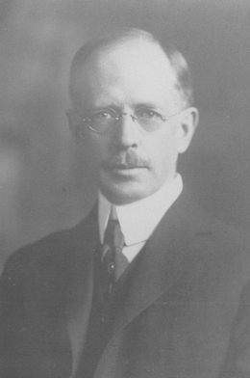

4:1-1o
“Gentlemen, I have been pursuing an
understanding of the grace of God
for over 60 years …
and I’ve just
now begun to understand it …
and gentlemen …
it’s tremendous.”
Grace: the Glorious
Theme © 1922
Lewis Sperry Chafer
(1871-1952)

Slide 29
4:1-1o

